Slide 1

HR Analytics Report: Workforce Insights & Strategic Recommendations
A deep dive into our organization's human capital for strategic growth.
Mangalesh B | January 2026

Slide 2
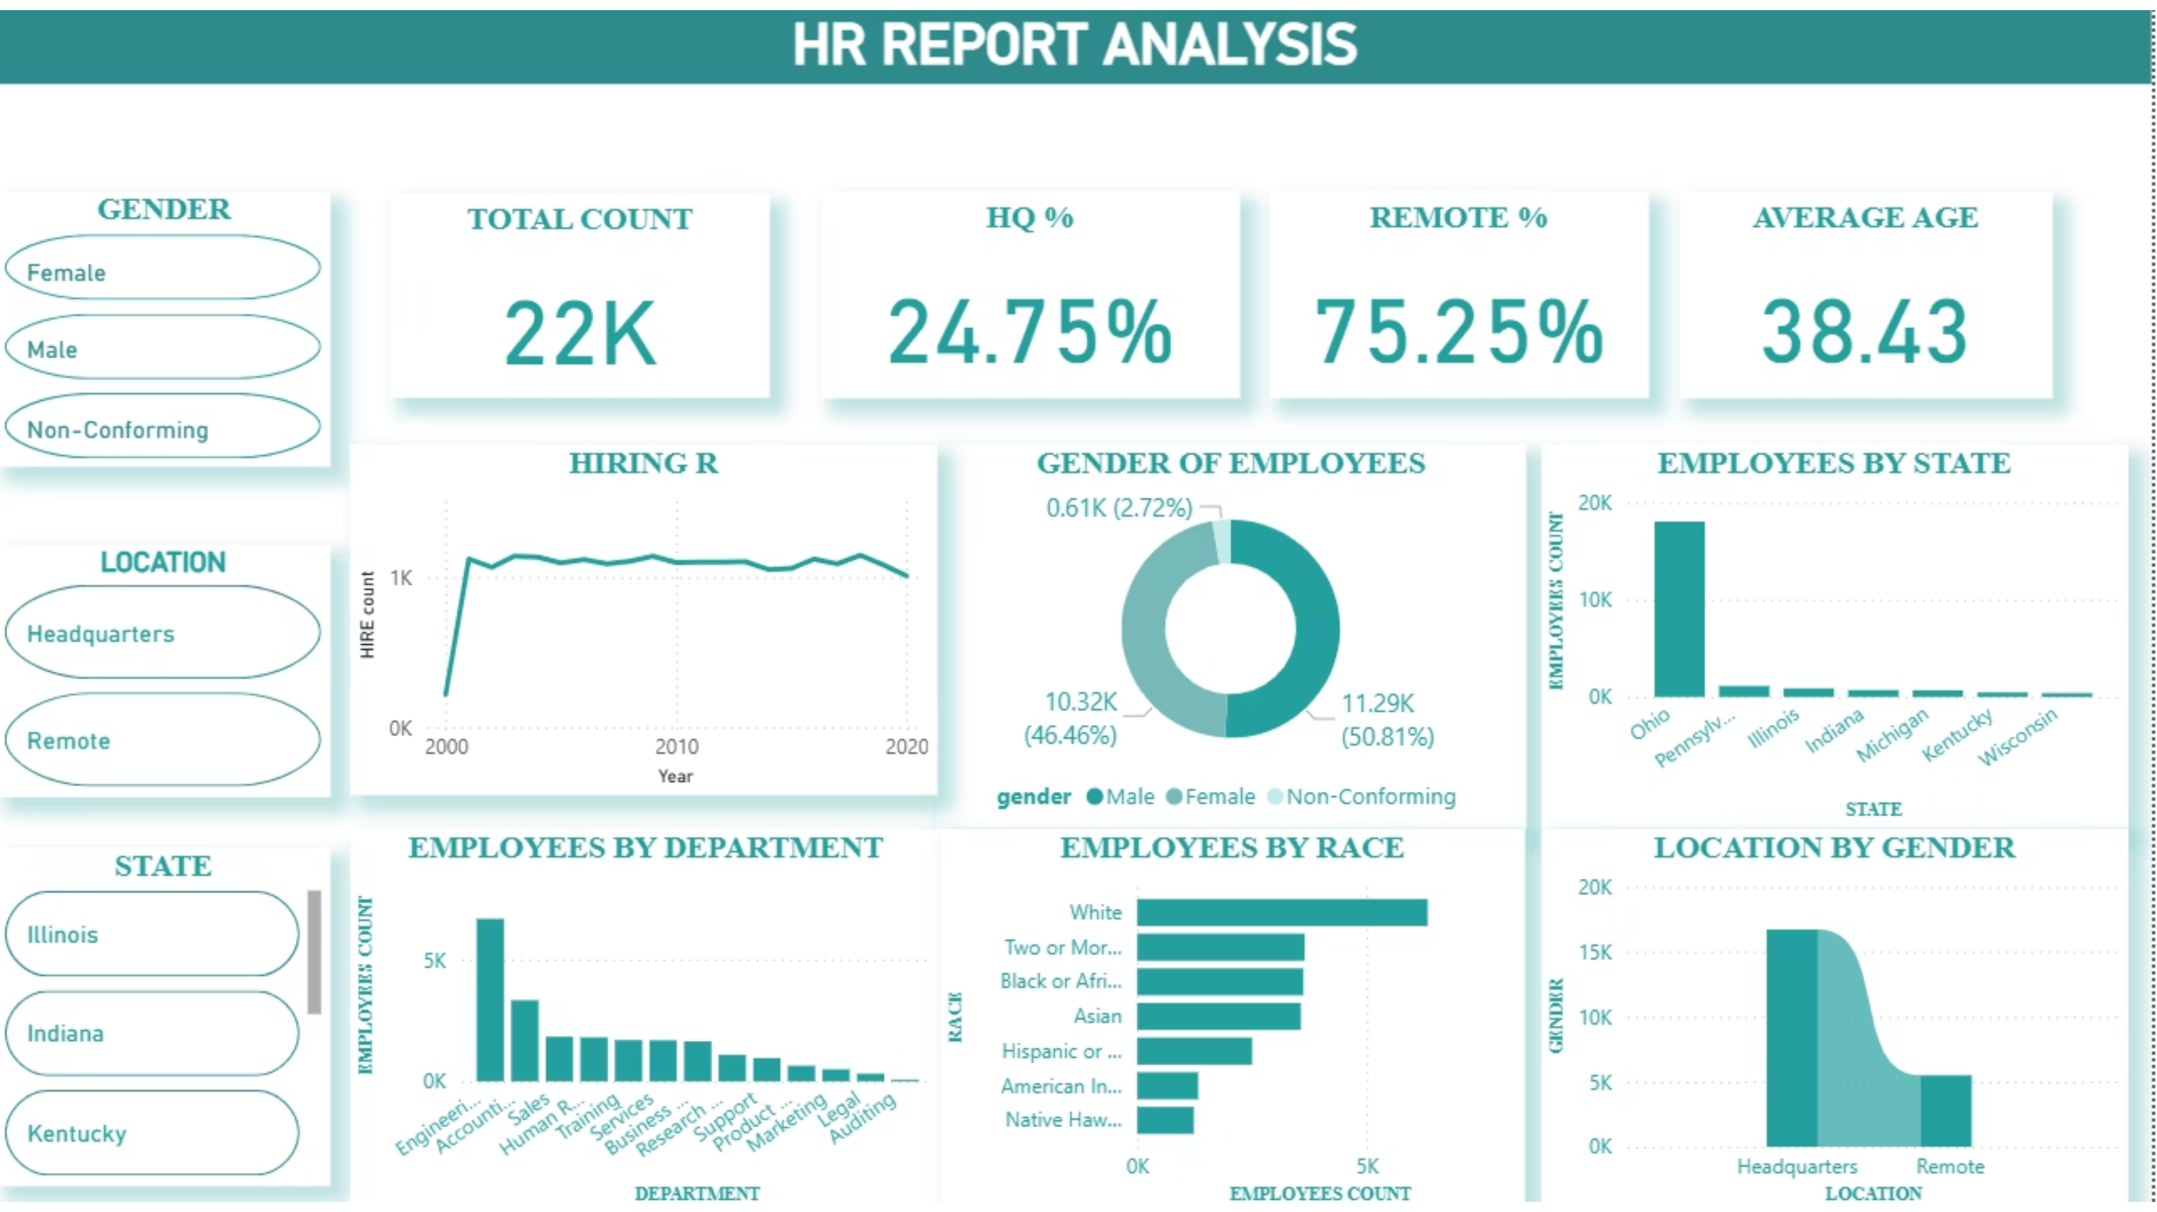

Slide 3

HR Dashboard Snapshot: Key Metrics at a Glance
22,214
38.52
24.65%
75.35%
Total Employees
Average Age
Remote Workforce
HQ-Based Staff
Our global workforce, driving innovation and growth.
A seasoned workforce bringing valuable experience.
Leveraging flexible work arrangements for efficiency.
The core of our operations and collaborative hub.
These foundational metrics highlight our current workforce composition, offering a baseline for further strategic analysis and planning.

Slide 4
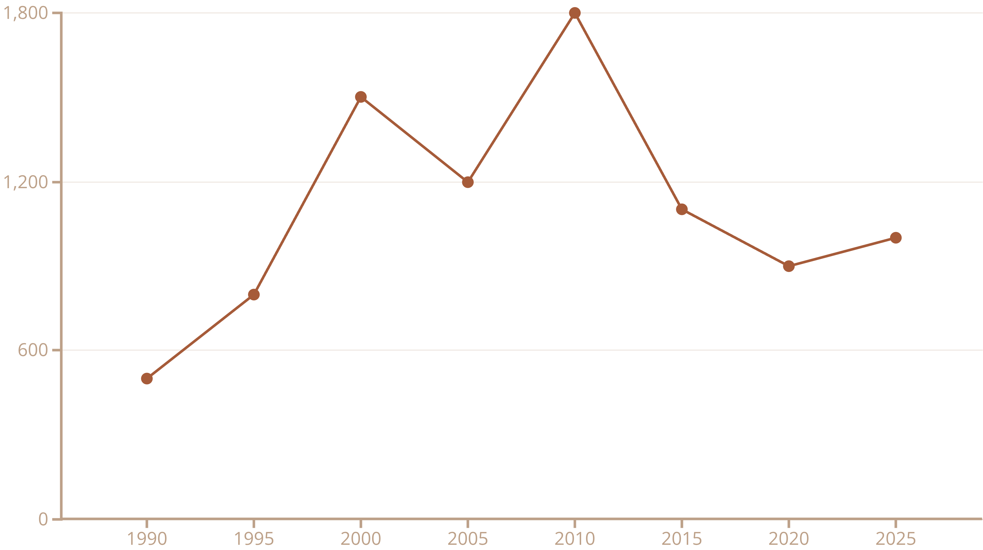
Hiring Trend Analysis: Sustained Growth & Talent Investment
The line chart illustrates a robust hiring trajectory, with significant peaks in the early 2000s and 2010s. We have maintained a sustained hiring rate of over 1,000 employees annually, reflecting continuous organizational growth and strategic investment in talent acquisition.

Slide 5
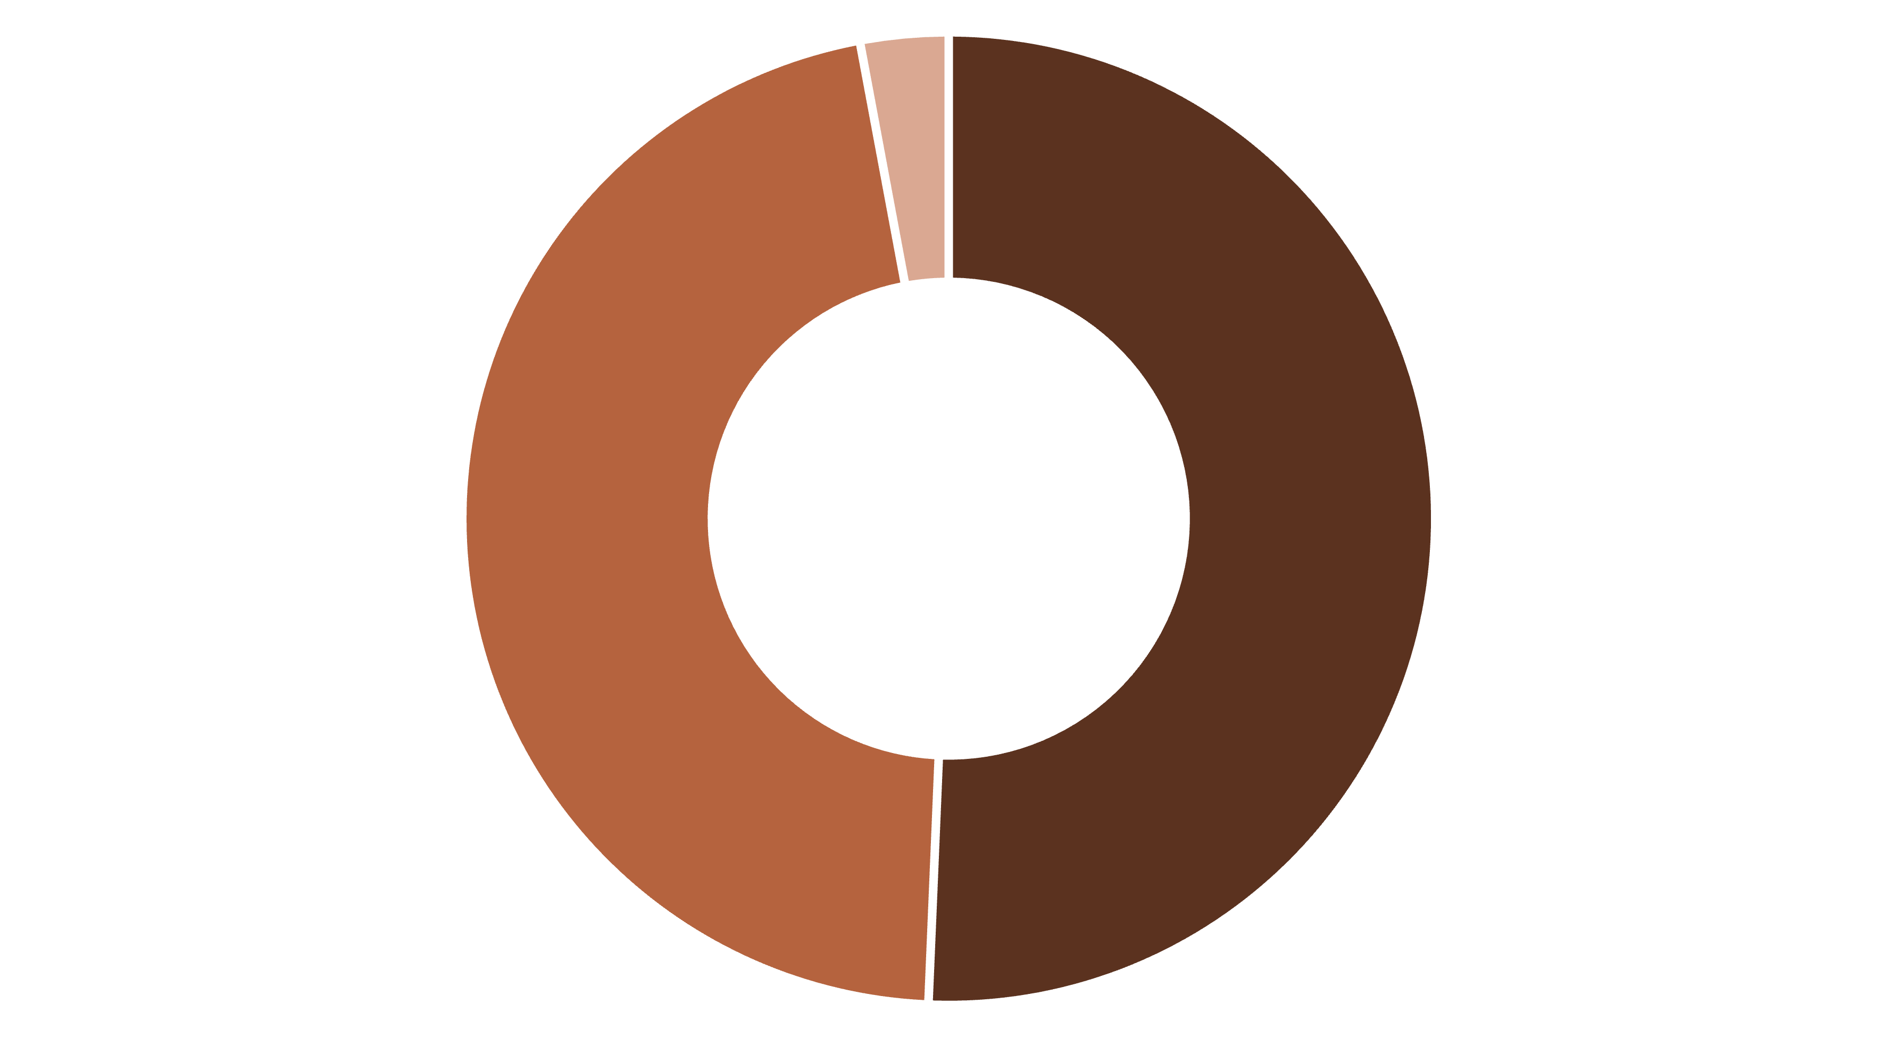
Gender Diversity: A Balanced & Equitable Workforce
Male
Female
Non-Conforming
Our workforce demonstrates a nearly balanced gender representation, a significant competitive advantage in today's talent market. This equitable distribution fosters diverse perspectives and enriches our organizational culture.

Slide 6
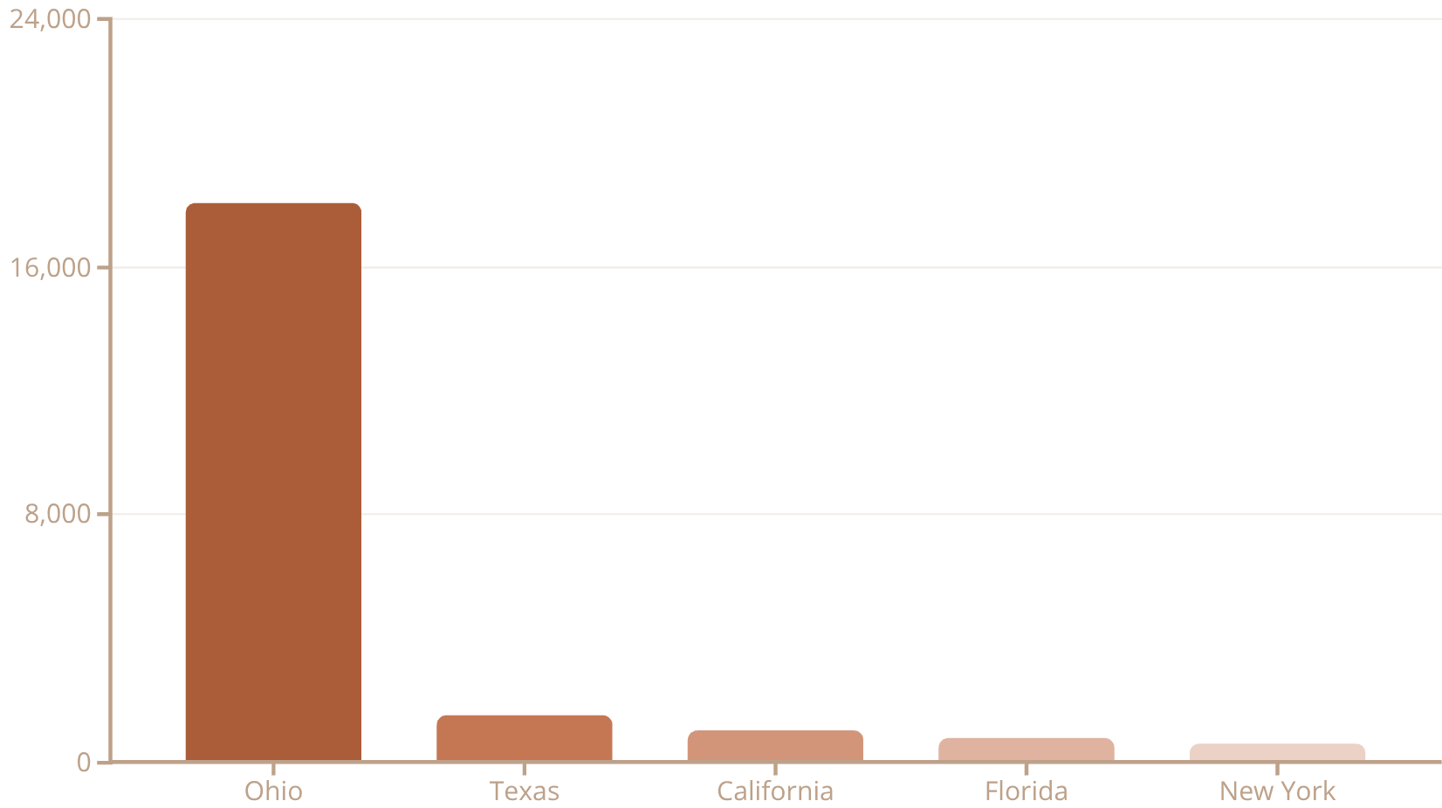
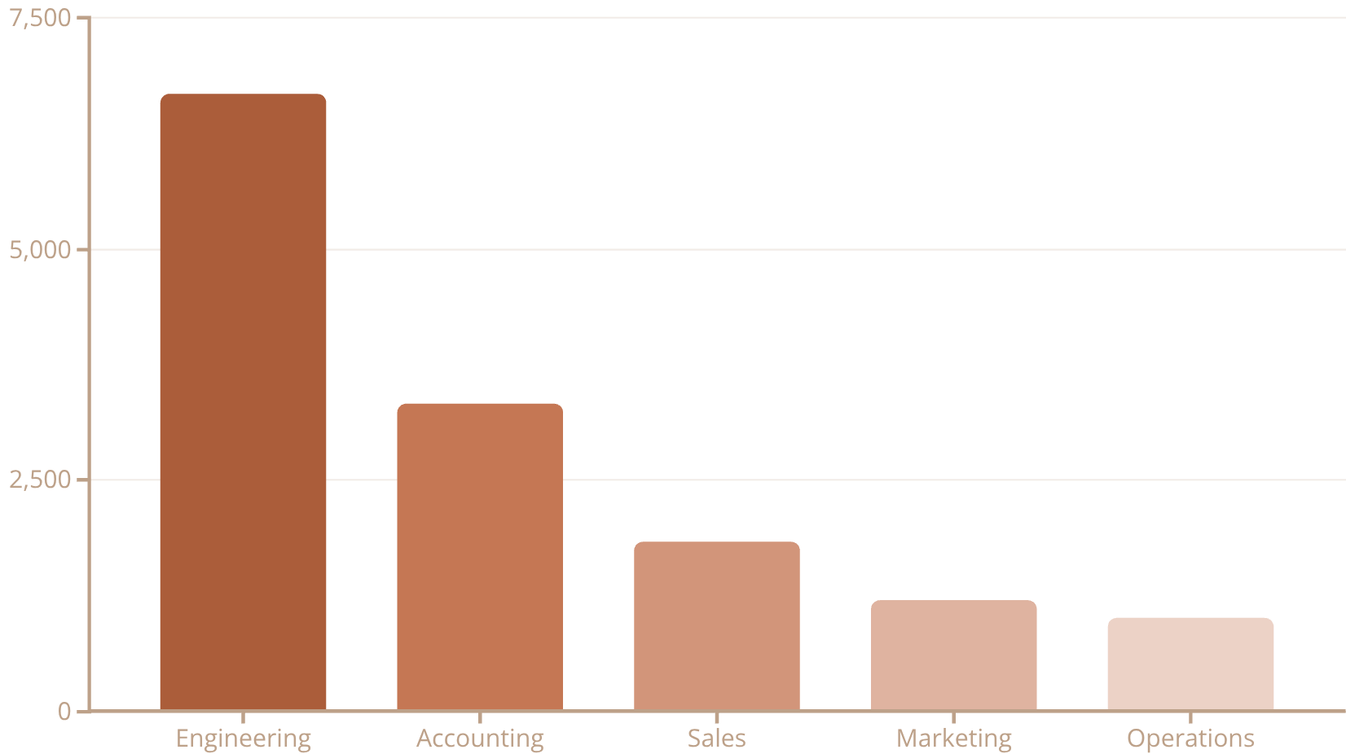
Geographic & Departmental Distribution: Concentration and Core Strengths
Employees by State
Employees by Department
These charts reveal a significant concentration of our workforce in Ohio, particularly within Engineering roles. This highlights our core operational hubs and specialized departmental strengths.

Slide 7
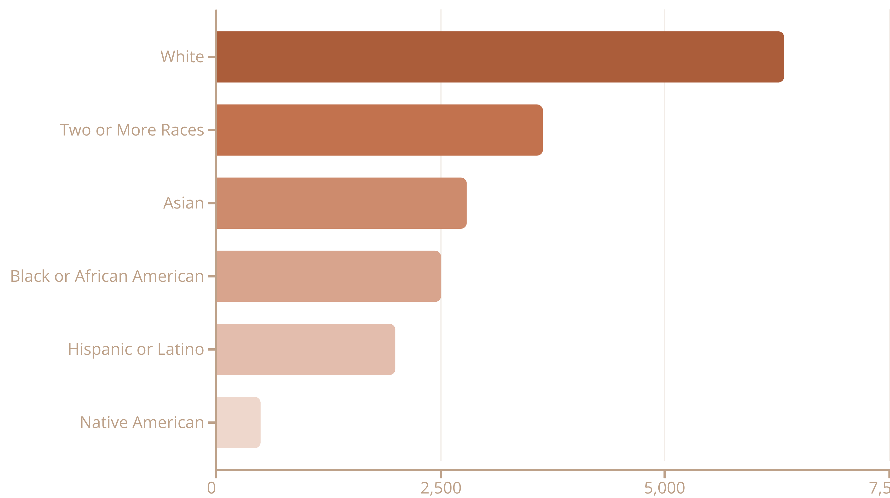
Racial Diversity Analysis: Broad Representation
Our organization embraces a diverse workforce, demonstrating broad racial and ethnic representation across various groups. This diversity enriches our culture and enhances problem-solving capabilities.

Slide 8
INSIGHTS
Key Insights & Strategic Findings
Workforce Concentration Risk
Engineering-Driven Structure
Strong Diversity Metrics
Balanced gender representation and broad racial diversity are key strengths.
High employee concentration in Ohio introduces potential single-point-of-failure risk.
Dominance of Engineering reflects our core business focus and innovation engine.
Aging Workforce
Remote Work Opportunity
Average age of 38.5 years necessitates proactive succession planning efforts.
Current 25% remote adoption signals potential for further expansion and flexibility.

